Slide 1
TRAFFIC MANAGEMENT USING IOT
TEAM MEMBER: SUNIL BHARATHI (822721106043)
IOT_Phase3 : Document submission
PROBLEM TITLE : Traffic management system

Slide 2
PROJECT DEVELOPMENT BASED ON TRAFFIC MANAGEMENT USING ARDUINO UNO AND RASPBERRY PI
Creating a complete traffic management system using an Arduino Uno and a Raspberry Pi is a complex project that involves various components, such as sensors, traffic lights, and communication between devices. Here, I'll provide you with a simplified example of how to create a basic traffic light control system using Python on the Raspberry Pi and an Arduino Uno.
Components Required:
Raspberry Pi
Arduino Uno
LED traffic lights
Ultrasonic sensor and Buzzer
Jumper wires
USB cable for connecting the Arduino to the Raspberry Pi
Software/Tools Required:
Python on Raspberry Pi
Arduino IDE for uploading code to the Arduino
PySerial library for communication between Raspberry Pi and Arduino

Slide 3
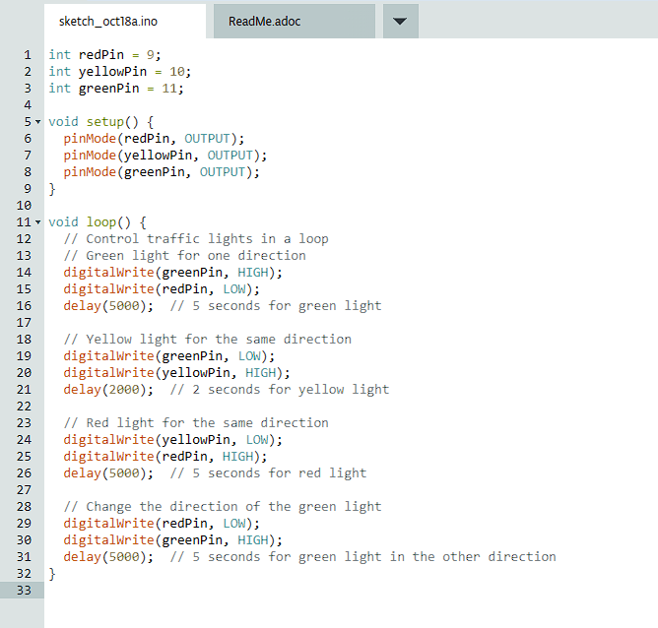
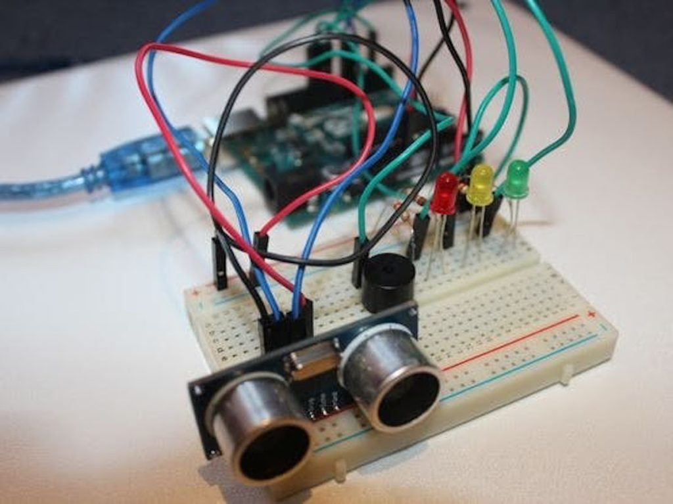
TRAFFIC MANAGEMENT BY USING ARDUINO UN0
Designing a traffic management system using Arduino Uno involves creating a system for controlling traffic lights based on specific rules, schedules, or real-time data. Below is an example project outline for a basic traffic management system using Arduino Uno. This project aims to demonstrate how the system can control traffic lights at a simple intersection.
This Photo by Unknown Author is licensed under CC BY-SA-NC

Slide 4
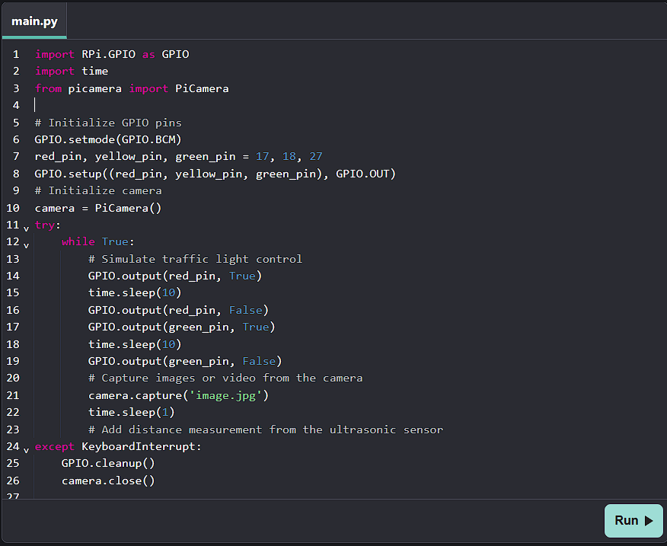
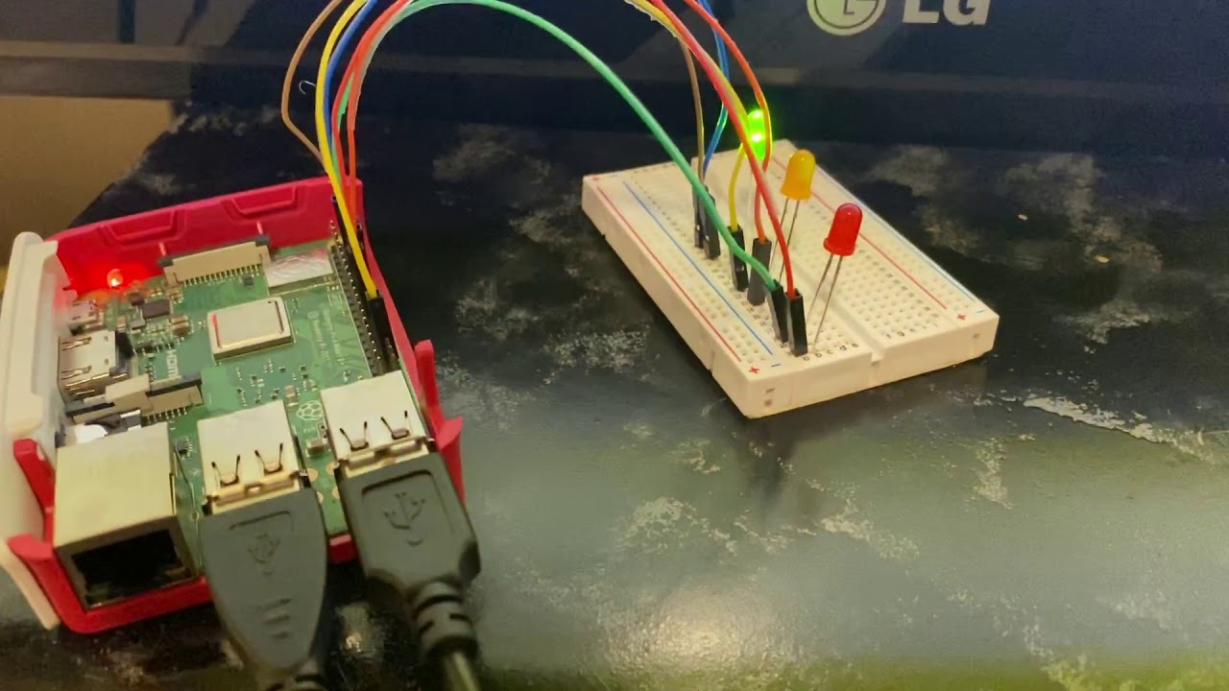
TRAFFIC MANAGEMENT BY USING RESPBERRY PI
Designing a traffic management project using a Raspberry Pi is a complex and multi-faceted task that involves various components, including sensors, cameras, data analysis, and traffic light control. Below is an overview of a project that demonstrates the principles of traffic management using a Raspberry Pi.

